Slide 1



Smart Helmet with SAFETY FEATURES
GROUP MEMBERS:
Diya Prakash - CB.SC.U4AIE24111
Dondluru Keerthana - CB.SC.U4AIE24112
V.R. Sridevi - CB.SC.U4AIE24166
Next Slide
1

Slide 2
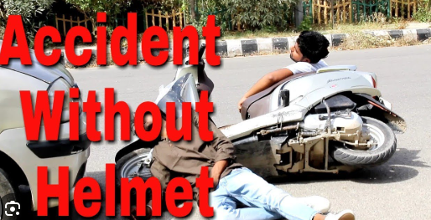
INTRODUCTION
Imagine a world where every ride is a safe ride. Our project introduces an intelligent helmet system designed to protect riders from common yet deadly risks—drunk driving, helmet non-compliance, and slow emergency response.
Next Slide
2

Slide 3
Problem Statement
Why Do We Need a Smart Helmet?
Key Issues:
Every hour, 17 lives are lost on Indian roads.
In 2022 alone, 4.5 lakh people lost their lives in road accidents.
Many of these fatalities could have been prevented if helmets were worn and emergency services responded faster.
Low helmet compliance – Many riders avoid helmets, risking their lives.
Drunk driving incidents – Alcohol remains a major cause of road fatalities.
Delayed medical response – Precious minutes are lost in getting help after an accident.
Our goal? To create a smart solution that tackles all these issues head-on.
Next Slide
3

Slide 4

OBJECTIVE
What if a helmet could do more than just protect your head?
Our smart helmet is a multi-functional safety system that:
✔ Ensures riders always wear a helmet before starting their bike.
✔ Detects alcohol levels and prevents drunk riding.
✔ Automatically senses accidents and sends emergency alerts.
✔ Tracks the rider’s location in real time to enable rapid assistance.
✔ Uses smart alerts to notify emergency contacts immediately.
Next Slide
4

Slide 5
LITERATURE
REVIEW
Methodology of the reference paper
What’s already out there?
What sets our project apart?
Smart helmet with helmet (transmitter) & bike (receiver) units.
IR sensor for helmet detection, MQ-3 sensor for alcohol detection.
RF communication, vibration sensor, GPS, and GSM for accident alerts.
We are integrating multiple safety layers—helmet compliance, accident detection, and real-time alerts—all in one comprehensive system.
What’s already out there?
Some smart helmets exist, but they lack a complete safety package.
Most focus only on one or two safety features, leaving critical gaps.
Limited communication protocols mean emergency alerts are unreliable.
Metrics Used
Why this paper?
Helmet compliance: Whether the system prevents ignition without a helmet.
Alcohol detection accuracy: Effectiveness of MQ-3 sensor in detecting intoxicated riders.
Accident response time: Speed of SOS alerts and GPS location tracking.
Communication reliability: RF module performance in real-world conditions.
Wireless & real-time safety system.
Enhances accident detection & emergency response.
Stronger foundation for future smart helmet designs.
Next Slide
5

Slide 6
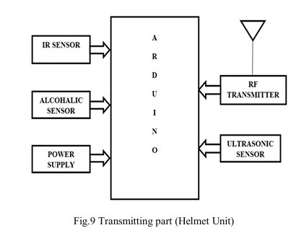
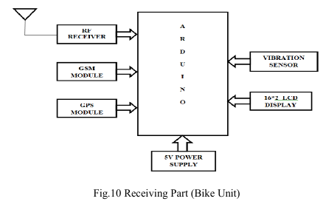
BLOCK DIAGRAM
Next Slide
6

Slide 7
SYSTEM ARCHITECTURE
1. Block Diagram Highlighting
The system is divided into three major sections:
Helmet Unit (Transmitter Components)
Worn by the rider and equipped with sensors to monitor helmet usage, alcohol levels, and accident detection.
Transmits critical safety data to the motorcycle unit wirelessly.
Motorcycle Unit (Receiver Components)
Installed on the motorcycle to receive data from the helmet unit.
Controls vehicle ignition based on helmet usage and alcohol detection.
Integrates emergency response mechanisms (GPS and GSM) in case of an accident.
Wireless Communication Pathway
Ensures real-time data exchange between the helmet and motorcycle unit.
Uses RF (Radio Frequency) communication to enable seamless and secure data transmission.
Next Slide
7

Slide 8
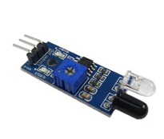
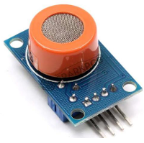
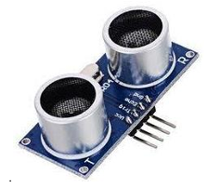
SYSTEM ARCHITECTURE
2. Key Components
a) Arduino Microcontroller
Serves as the central processing unit for both the helmet and motorcycle unit.
Collects sensor data, processes it, and triggers necessary actions.
Ensures real-time decision-making and system automation.
b) Multiple Sensors
IR Sensor (Helmet Wearing Detection)
Detects whether the rider is wearing the helmet.
MQ-3 Alcohol Sensor (Drunk Driving Prevention)
Measures alcohol concentration in the rider’s breath.
Vibration Sensor (Accident Detection)
Identifies sudden impact or crashes.
Triggers emergency response by sending alerts.
Ultrasonic Sensor (Proximity Detection)
Detects nearby vehicles and objects.
Provides safety alerts to the rider to prevent collisions.
Next Slide
8

Slide 9
SYSTEM ARCHITECTURE
c) Communication Modules
RF Transmitter and Receiver
Facilitates wireless data exchange between the helmet and motorcycle unit.
Ensures low-latency and interference-free communication.
GSM Module (Emergency Alerts)
Sends SMS alerts to emergency contacts in case of an accident.
Provides real-time updates about the rider’s condition.
GPS Module (Real-Time Location Tracking)
Accurately tracks the rider’s location.
Helps in rapid emergency response during accidents.
Next Slide
9

Slide 10
1. Helmet Wearing Enforcement
An IR sensor inside the helmet detects if the rider is wearing it.
If the helmet is removed while riding, an alert system (buzzer/vibration) warns the rider.
Helps enforce continuous helmet usage and prevents risky riding behaviour.
2. Alcohol Detection System
The MQ-3 alcohol sensor measures the rider’s breath alcohol level
If the system detects alcohol, an alert message is sent to a registered emergency contact.
Helps prevent drunk driving and potential accidents due to intoxication.
3. Accident Detection Protocol
A vibration sensor detects sudden impacts or crashes.
If the impact exceeds a predefined threshold, the system assumes an accident has occurred.
Once an accident is detected, the system automatically triggers an emergency alert via the GSM module.
An SOS message is sent to emergency contacts and local medical services.
The GPS module provides the precise accident location in real time.
Helps emergency responders reach the accident site quickly, improving the chances of saving lives.
Safety Features
Workflow
Next Slide
10

Slide 11
Technical Challenges & Solutions
1️⃣ Sensor Calibration
Challenge: Sensors may produce inaccurate readings due to environmental conditions (temperature, humidity, vibrations).
Mitigation: Use advanced signal processing techniques to filter noise and improve accuracy.
2️⃣ Communication Reliability
Challenge: Wireless data transmission may face interference, delays, or loss.
Mitigation: Implement redundant communication protocols (RF & GSM) to ensure seamless data flow.
3️⃣ Power Consumption
Challenge: Multiple sensors and communication modules may drain battery life quickly.
Mitigation: Adopt efficient power management, such as low-power components, sleep modes, and optimized power distribution.
Key Takeaway: Smart optimization techniques ensure reliable, efficient, and accurate system performance.
CHALLENGES
AND
MITIGATION
Next Slide
11

Slide 12
CONCLUSION
This project demonstrates a significant step forward in enhancing road safety through innovative technology. By integrating smart helmet features such as mandatory helmet detection, alcohol sensing, and real-time accident alerts, the system not only ensures rider protection but also promotes responsible driving behavior. The innovation lies in its seamless integration of sensor data, wireless communication, and automated emergency response, making it a scalable solution for broader applications in traffic safety management. With its potential to reduce road accidents and improve emergency response times, the smart helmet project promises considerable societal benefits and lays the groundwork for future advancements in intelligent transportation systems.
Next Slide
12

Slide 13
Thank
You!
13

